Slide 1
Health Insurance
Expenses prediction
Rosanna
Using Machine Learning to predict annual medical spending for new customers.
Notes:
We chose Health Risk prediction because of its importance in everyday life and also because it’s a sector that truly embraces cutting edge artificial intelligence and robotics.

Slide 2




Hello! This is Group 7
Rosanna
Group Members:
Trey Lumley
Rosanna Reza-Giles
Mika Mohammadyani
Martha Griggs

Slide 3
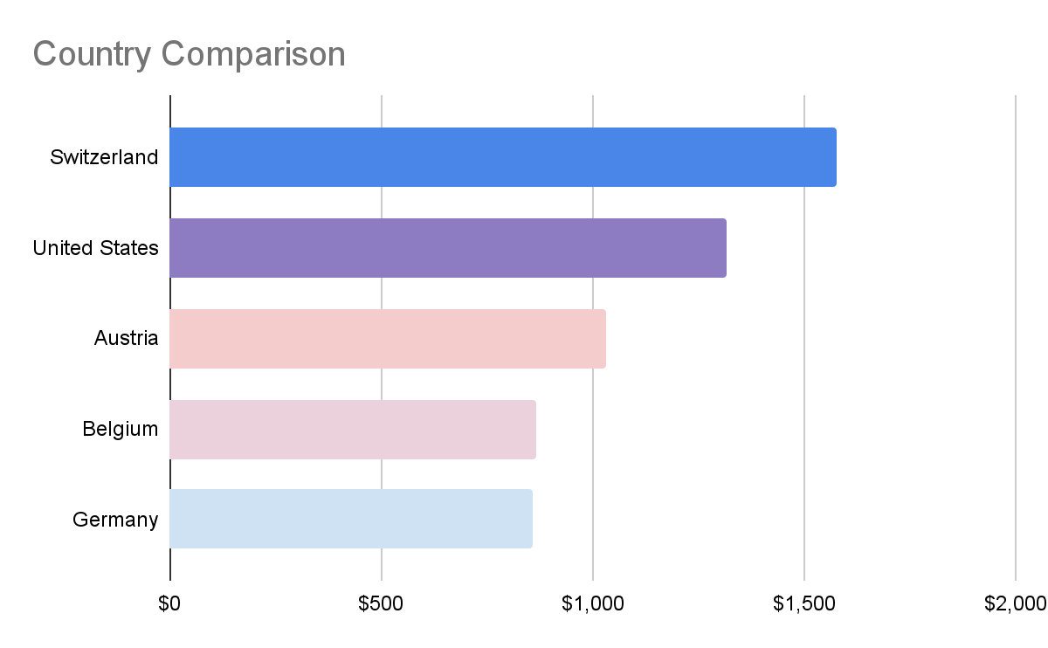
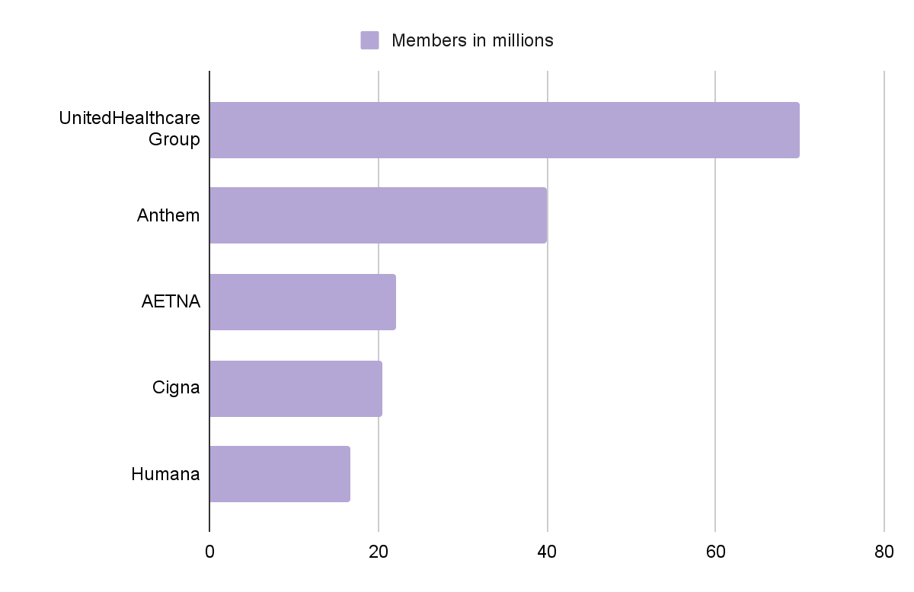
State of Healthcare
Rosanna
Largest Health Insurance In US 2021
Notes:
The health insurance industry in the United States is a combination of both private and publicly funded companies. The largest is provider is UnitedHealthcare Group with 70 million members. The United States spends $1,315 per capita, only Switzerland spend more ($1577 per capita) than the US.
Industries within the healthcare sector include drugs, medical equipment, managed healthcare, and healthcare facilities.

Slide 4


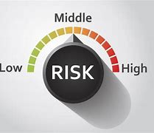
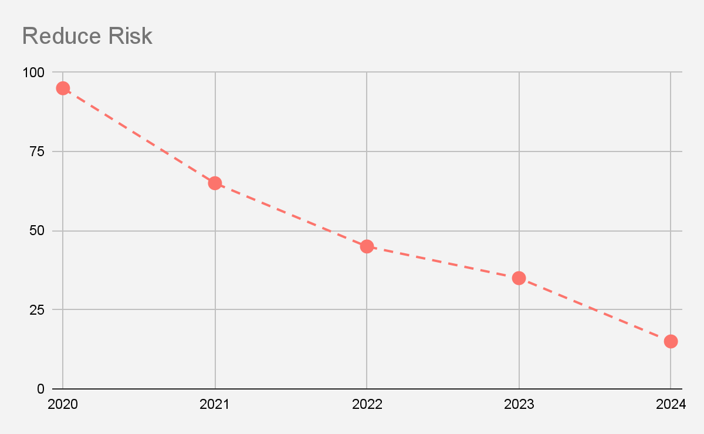
Health Risk Assessment Process
DAta Collection
Risk Identification
Risk Stratification
Risk Adjustment
Rosanna
Notes:
Health insurance risk assessment is the process by which insurance companies evaluate and assess the risks attached to insurance policies. They use data algorithms and statistics to determine the likelihood of policyholders filing claims and the potential financial harm to the insurers. The goal is to create policies that are fair and reflect the risks involved, as well as to balance the insurers' profitability and claims ¹.
Future trends take into account enormous pressure from people living longer, shortage of professionals and trends in healthcare.
Preventative models
Trends in Healthcare:
Preventive model - telehealth and health monitoring applications
Democratized health care - aps, chatbots
Personalized predictive precision , devices that we wear.
Digitized healthcare
Body and biohacking (Neuralink has recently been approved for human trials.)
Robotics nanobots-exoskeleton
Datafication will fuel $85 billion by 2027
Source Bernard Marr the 7 Biggest Future Trends In HealthCare

Slide 5
Goal: use machine learning to estimate the annual medical spending of new customers
01
02
03
04
Rosanna
Exploratory Analysis and Visualization
Linear Regression
Gradient Boosting Regressor and Random Forest Regressor
Trial and Error
Notes:
We would use the charges column as our target against the other columns to be able to estimate charges for new customers when given the same information (sex, BMI, smoking history, number of children and region).
The dataset contained no null values, the only changes to dataset would come when we needed to encode the categorical data contained in the sex, smoker and regions columns.

Slide 6
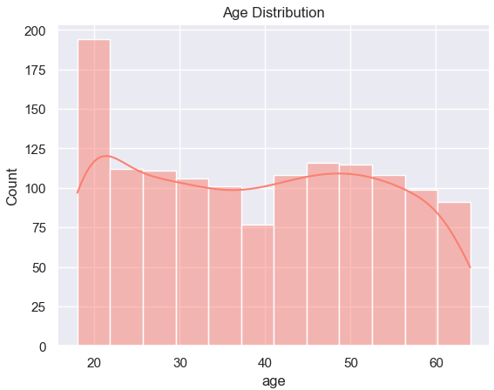
Exploratory Analysis and Visualization
Martha
Notes:
The dataset contains 1338 rows and 7 columns. Each row of the dataset contains information about one customer.
We will be using the charges column as our target against the other colums to be able to estimate chargest for new customers when given the same information(sex, BMI, smoking status, number of children and region).
The dataset contained no null values, the only changes to the dataset would come when we needed to encode the categorical data contained in the sex, smoker and regions columns.
The ranges of values in the numerical columns seem reasonable too. The charges column seems to be significantly skewed however, as the median (50 percentile,it is also known as 2nd quartile) is much lower than the maximum value.
We can see that a majority of our dataset is well-balanced with regard to Age.
The minimum age for the dataset is 18 and the maximum age is 64. Males and females are mostly equally represented in this dataset(676 male, 662 females)
The age is fairly evenly distributed, except for the 18 and 19 year old, there are about twice as many customers as the other ages → Insurance agencies will charge more the older you are, on the same note, younger people tend to have lower premiums.

Slide 7
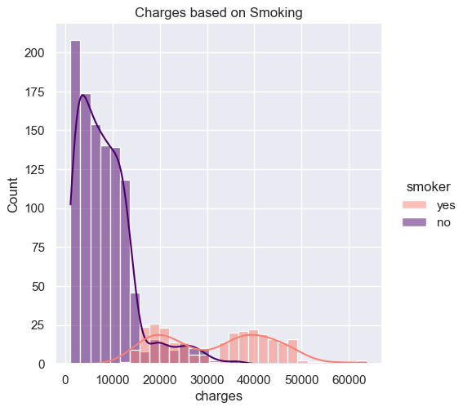
Exploratory Analysis and Visualization
Martha
Notes:
Another column that we initially thought might tell quite a bit about health care charges was smoking status.
Here we have charges based on smoking.
From first glance, we can see that most people in the dataset fall between $1,000-$10,000 in annual medical care costs.
lowest charge: 1121
max charge 63770 → these could be due to extreme medical emergencies, hospital stays or chronic illnesses.
average charge 13270 → the charges column does seem to be skewed in general because the median(or 2nd quartile) is much lower than the maximum value.
Displayed in purple are non-smokers and most of them seem to belong in the lower bracket of between of annual insurance spending.
Displayed in peach are the smoking group, Smokers in this dataset are having more annual charges for medical care cost, even though there are significantly less smokers in the dataset than nonsmokers (1064 no, 274 yes).

Slide 8
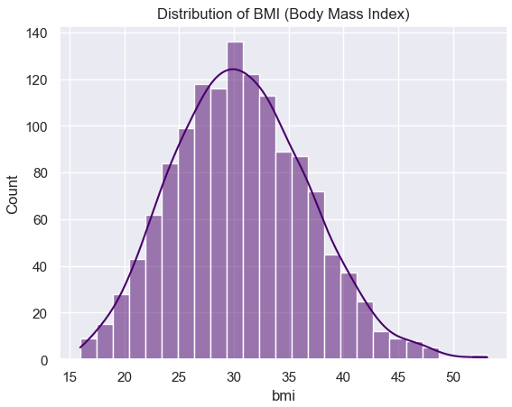
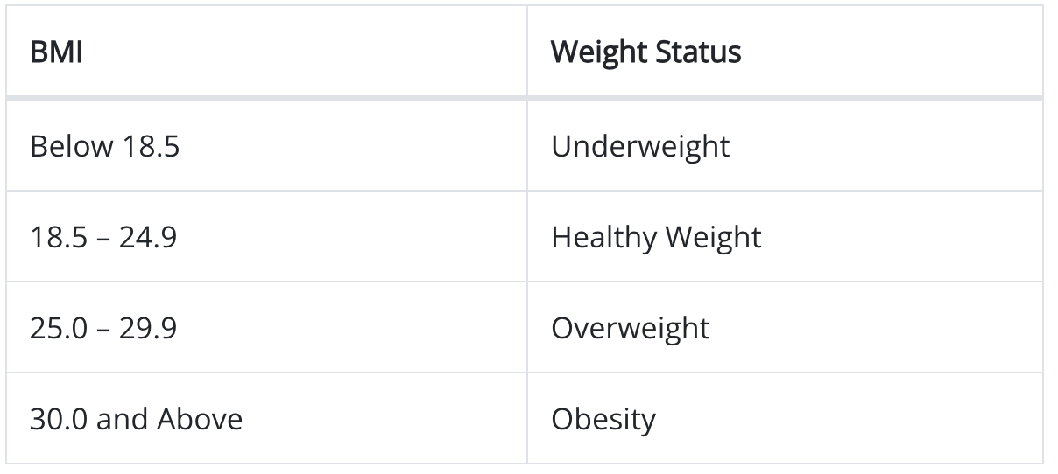
Exploratory Analysis and Visualization
Trey
Source: BMI Table - CDC. https://www.cdc.gov/healthyweight/assessing/bmi/adult_bmi/index.html#Interpreted
Notes:
This is a simple bar chart showing the BMI of the dataset. Next to it is a table is the CDC’s measurements for body-mass index. One insight that sticks out is that the majority of our dataset is considered “Overweight” or “Obese”. We decided to create a visual to see if BMI has any influence over charges.

Slide 9
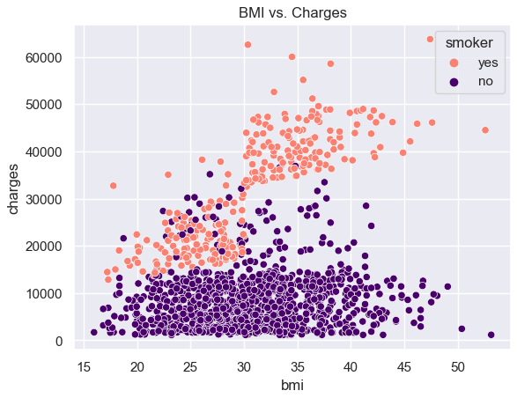
Exploratory Analysis and Visualization
Trey
Notes:
Although smoking status and BMI are not directly correlated to each other, we can see that there is a significant spike in the charges incurred by a smoker who falls into the obese category (<30 BMI).

Slide 10
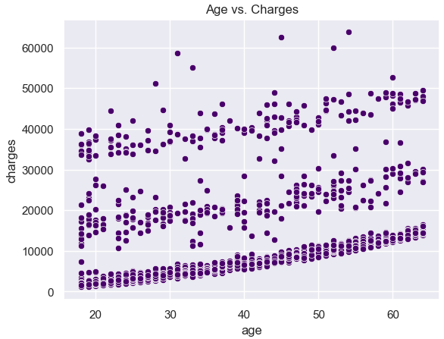
Exploratory Analysis and Visualization
Trey
Notes:
Looking at the ages of the the dataset measured against the charges incurred, we can see a steady trend of increased costs as the participants increase in age.
We were able to distinctively see that there are three mysterious sections splitting the data points.
We attempted to do some further analysis, but were unable to identify if those sections belonged to a third dimension in the data.

Slide 11
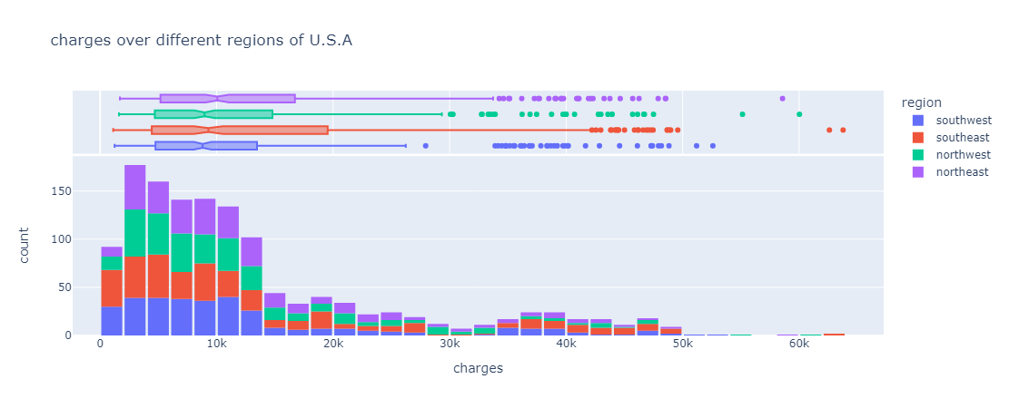
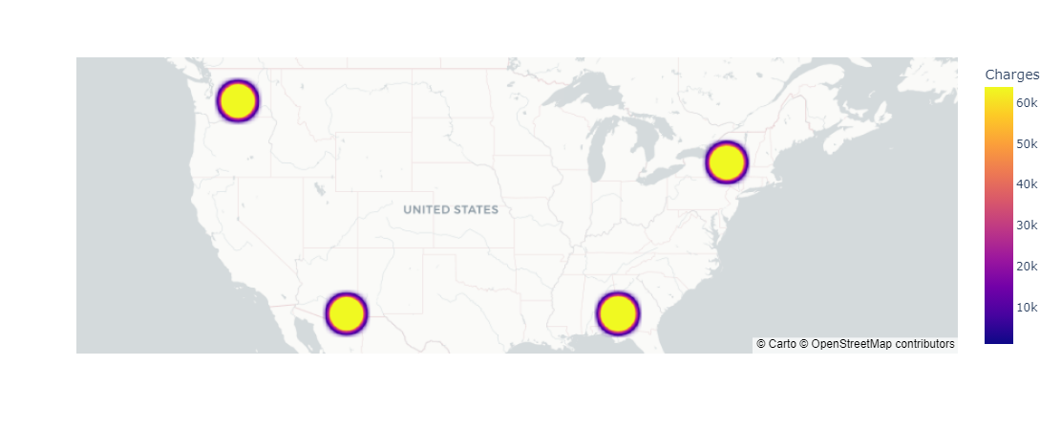
Distributions of Charges across different REGIONS
Mika

Slide 12
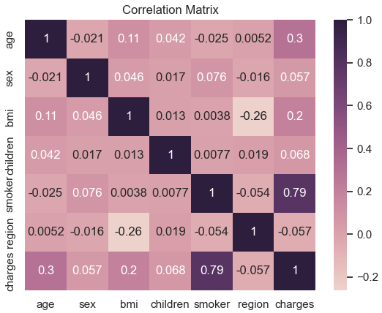
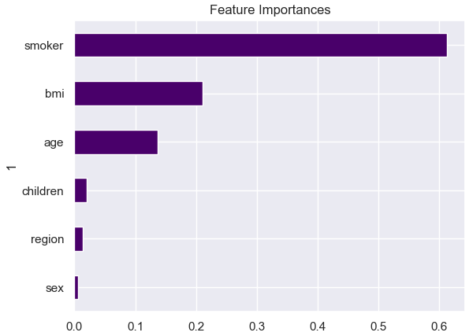
Columns closely related to ‘charges’
Martha
The matrix shows that smoker has the highest correlation relationship with charges, followed by age and BMI.
RandomForestRegressor confirmed our correlations and also showed that smoker, BMI and age were the most important features
Notes:
We started thinking that we could use logistical regression with this dataset, but realized quickly that would not work because our target (charges)was numerical. We also could not use a RandomForest Classifier with this data, but we found some success when using RandomForest Regressor.
After changing the categorical data to numerical data we were able to use RandomForest Regressor to train and test a model using our data. We did suspect that the bmi and smoker columns would be important to determining charges and the correlation matrix confirmed that along with age, these columns were more closely related to charges than other columns.
The greater the absolute value of the correlation coefficient, the stronger the relationship. Positive coefficients show that when the value of one variable increases, the value of the other variable also tends to increase. Positive relationships will show an upward slope on a scatterplot.
Negative coefficients represent cases when the value of one variable increases, the value of the other variable tends to decrease. This would produce a downward slope.
We used the Random Forest Regressor and it showed that smoker had the highest feature importance. We did run the RandomForest model with the data as is and again with the data scaled. There was not significant change in findings.
I was looking around at other Regression options available with scikitlearn and ran a gradient boosting regression on the model.
Random Forest Regressor - Trained multiple decision trees on different subsets of the dataset, then averaging their predictions to achieve higher accuracy and control overfitting
Gradient Boosting Regressor (Optimizer) - A popular optimization technique often used in various types of regression models to iteratively adjust the model parameters in order to minimize a cost function. It aims to optimize an ensemble of models by iteratively adding new models - r2: 0.8672163144882827 - mean squared error: 0.12493584494104029
Regression: In Regression, the output is continuous data. In this method, we predict the trends of training data based on the features. The result does not belong to a certain category or class, but it gives a numeric output that is a real number

Slide 13
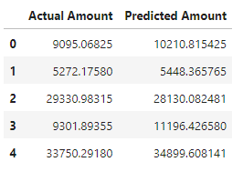
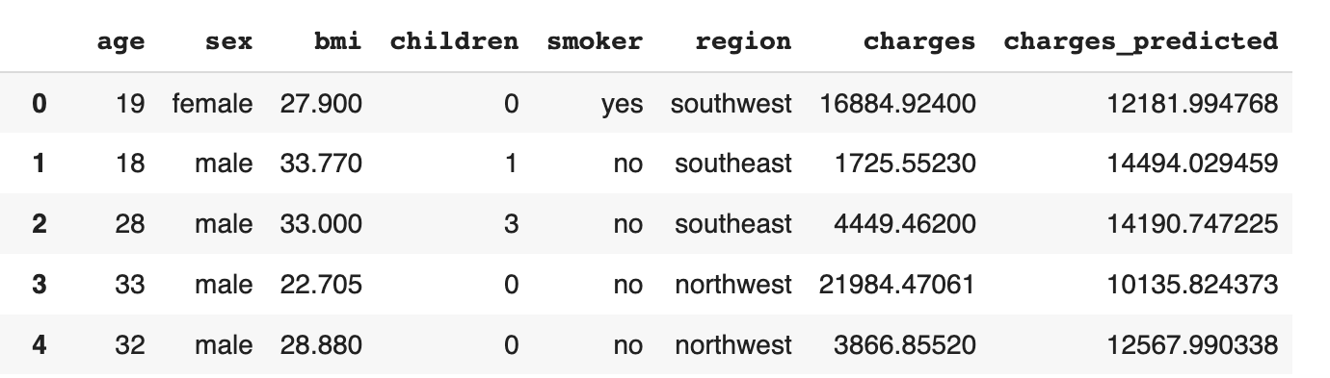
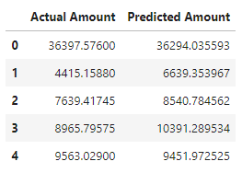
Regression methods:
Martha
Random Forest Regressor Predictions
Linear Regression Predictions
- r2: 0.8622649866860468 - mean squared error: 0.1481511086093162
- r2: 0.7833463107364536 - mean squared error: 0.22952487683968573
Gradient Boosting Regressor (Optimizer)
- r2: 0.8672163144882827 - mean squared error: 0.12493584494104029
Notes:
Another model we used was Linear Regression
Linear Regression - Used to predict a continuous target variable based on one or more input features, assuming a linear relationship between the input variables and the output.
As you can see our linear regression model was not quite where we wanted it to be, so when we ran other Machine Learning Models the results were slightly better. The target column was charges, which were in dollar amounts and once data that was scaled was inverted back to dollar amounts, it is easier to see that our gradient and random forest regressor’s did about the same in predicting charges that customers would accrue.
This would potentially be used by an insurance company to decide what premium amount to charge a new customer based on information gathered about their health history.
As mentioned before, there was not a real significant change in results when the data was scaled or not. Using only the top 3 features to run the random forest regressor and gradient boosting regressor models did not provide any significant changes.

Slide 14
What is this dataset Lacking?
Mika
The model would benefit from more columns
Pregnancies or other hospital visits
High Blood Pressure
Heart Disease
Work Type
Medications
Pre-Existing Condition
Source Confirmation
Balance of participants on smoking/non-smoking category

Slide 15
Trial and Error
Mika
Trying different ML models
At the beginning of our project, we weren’t sure which model to start with and we had to re-familiarize ourselves with ML concepts before we could make any confident predictions. We determined that Random Forest and Gradient Boosting were the most reliable model and optimizer.
Narrowing down the goals
Though we had columns that we thought would be related to the charges column, we ran a Correlation Matrix with a heatmap to see which columns would be most relevant for ML training. We then ran a RandomForestRegressor to confirm our thoughts based on the matrix’s outcome.
Learning as we go
There weren’t very many moments in the beginning stages where we could tell which data would be good to use and which data we wish we had, not to mention the accuracy of the data. As we did our exploratory analysis and ran our models a few times, the picture became clearer as to what we had and what we needed for an insightful presentation.

Slide 16
Thank you!
Do you have any questions?

Slide 17
Credits.
Presentation Template: SlidesMania
Images: Unsplash
Fonts used in this presentation: DM Sans and Unica One

